Slide 1
Module 4: Attacking What We Do
Instructor Materials
Cybersecurity Essentials 3.0
Notes:
Cybersecurity Essentials 3.0
Module 4: Attacking What We Do

Slide 2
Instructor Materials – Module 2 Planning Guide
This PowerPoint deck is divided in two parts:
Instructor Planning Guide
  Information to help you become familiar with the module
  Teaching aids
Instructor Class Presentation
  Optional slides that you can use in the classroom
  Begins on slide # 10
  Note: Remove the Planning Guide from this presentation before sharing it with anyone.

Slide 3
What to Expect in this Module
To facilitate learning, the following features within the UI may be included in this module:
Feature | Description
Avatar | A virtual character, representing a subject matter expert, adds additional contextual information to skills the students have learned and helps them connecting the dots, by asking open reflection questions.
Animations | Expose learners to new skills and concepts.
Videos | Expose learners to new skills and concepts.
Check Your Understanding | Per topic online quiz to help learners gauge content understanding.
Interactive Activities | A variety of formats to help learners gauge content understanding.
Syntax Checker | Small simulations that expose learners to Cisco command line to practice configuration skills.
PT Activity | Simulation and modeling activities designed to explore, acquire, reinforce, and expand skills.

Slide 4
What to Expect in this Module (Cont.)
To facilitate learning, the following features within the UI may be included in this module:
Feature | Description
Hands-On Labs | Labs designed for working with physical equipment.
Module Quizzes | Self-assessments that integrate concepts and skills learned throughout the series of topics presented in the module.
Module Summary | Briefly recaps module content.

Slide 5
Check Your Understanding
Check Your Understanding activities are designed to let students quickly determine if they understand the content and can proceed, or if they need to review.
Check Your Understanding activities do not affect student grades.
There are no separate slides for these activities in the PPT. They are listed in the notes area of the slide that appears before these activities.

Slide 6
Module 4: Activities
What activities are associated with this module?
Page # | Activity | Activity Name | Optional?
4.1.7 | Lab | Exploring DNS Traffic | Recommended
4.2.6 | Video | Install a Virtual Machine on a Personal Computer | Recommended
4.2.7 | Lab | Install a Virtual Machine on a Personal Computer | Recommended
4.2.8 | Lab | Attacking a MySQL Database | Recommended
4.2.9 | Lab | Reading Server Logs | Recommended
4.2.10 | Check Your Understanding | Check Your Understanding - Enterprise Services | Recommended
4.3.7 | Lab | Recommend Threat Mitigation Measures | Recommended

Slide 7
Module 4: Best Practices
Prior to teaching Module 4, the instructor should:
Review the activities and assessments for this module.
Try to include as many questions as possible to keep students engaged during classroom presentations.
Topic 4.1
  Ask the students to identify a vulnerability with the ARP protocol and explain how several MiTM attacks can be launched by threat actors using this protocol.
  Describe in detail the four types of DNS attacks.
  Explain the DHCP spoofing attack.
  Encourage the students to do the 4.1.7 Lab to capture and stores DNS traffic.

Slide 8
Module 4: Best Practices (Cont.)
Topic 4.2
  Explain the common stages of a typical web attack.
  Encourage the students to look at the best security practices from the Open Web Application Security Project (OWASP) when developing web applications.
  Introduce the common HTTP exploits and ask the students to give suggestions to prevent or reduce this types of attacks.
  Ask the students to give examples of email threats and share some experience they had with these type of attacks.
  Explain the types of XSS attacks and ways to prevent them.
  Recommend the students to watch the 4.2.6 Lab Video to see how to install a virtual machine on a PC and then ask the students to do the 4.2.7 Lab to apply what they learned from the video.
  Ask the students to do the 4.2.8 and 4.2.9 Labs

Slide 9
Module 4: Best Practices (Cont.)
Topic 4.3
  Ask the students to suggest best practices to secure the network and then explain the mitigation techniques for each type of threat.
  Strongly recommend the student to do the 4.3.7 Lab to review incidents at some companies and see recommendations measures for threat mitigation.

Slide 10
Module 4: Attacking What We Do
Cybersecurity Essentials 3.0
Notes:
Cybersecurity Essentials 3.0
Module 4: Attacking What We Do

Slide 11
Module Objectives
Module Title: Attacking What We Do
Module Objective: Recommend measures to mitigate threats.
Topic Title​ | Topic Objective​
IP Services​ | Explain IP service vulnerabilities.
Enterprise Services | Explain how network application vulnerabilities enable network attacks.
Mitigating Common Network Attacks | Recommend basic threat mitigation measures.

Slide 12
4.1 IP Services
Notes:
4: Attacking What We Do
4.1: IP Services

Slide 13
IP Services
ARP Vulnerabilities
Hosts broadcast an ARP Request to other hosts on the network segment to determine the MAC address of a host with a particular IP address. The host with the matching IP address in the ARP Request sends an ARP Reply.
Any client can send an unsolicited ARP Reply called a “gratuitous ARP.”
When a host sends a gratuitous ARP, other hosts on the subnet store the MAC address and IP address contained in the gratuitous ARP in their ARP tables.
Any host can claim to be the owner of any IP/MAC they choose.
Threat actors can poison the ARP cache of devices on the local network, creating an MiTM attack to redirect traffic.
The goal is to associate the threat actor’s MAC address with the IP address of the default gateway in the ARP caches of hosts on the LAN segment.
It positions the threat actor between the victim and all other systems outside the local subnet.
Notes:
4: Attacking What We Do
4.1: IP Services
4.1.1: ARP Vulnerabilities

Slide 14
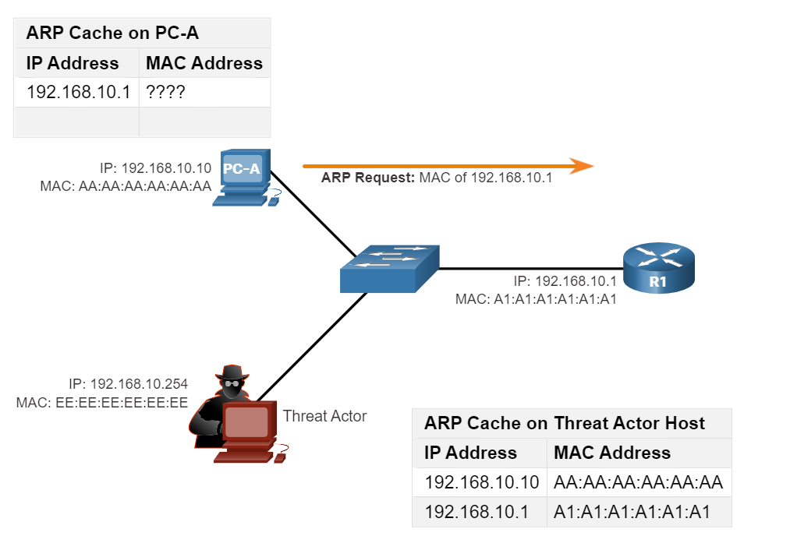
IP Services
ARP Cache Poisoning
ARP Request
The figure shows how ARP cache poisoning works.
PC-A requires the MAC address of its default gateway (R1); therefore, it sends an ARP Request for the MAC address of 192.168.10.1.
Notes:
4: Attacking What We Do
4.1: IP Services
4.1.2: ARP Cache Poisoning

Slide 15
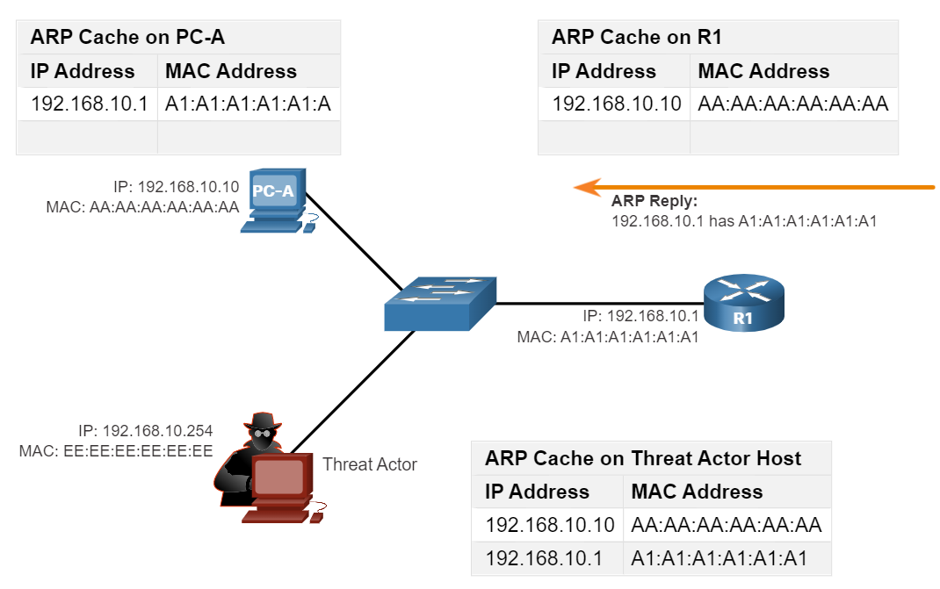
IP Services
ARP Cache Poisoning (Cont.)
ARP Reply
In this figure, R1 updates its ARP cache with the IP and MAC addresses of PC-A.
R1 sends an ARP Reply to PC-A, which then updates its ARP cache with the IP and MAC addresses of R1.
Spoofed Gratuitous ARP Replies
Passive ARP poisoning occurs when threat actors steal confidential information.
Active ARP poisoning occurs when threat actors modify data in transit or inject malicious data.
Notes:
4: Attacking What We Do
4.1: IP Services
4.1.2: ARP Cache Poisoning (Cont.)

Slide 16
IP Services
DNS Attacks
A DNS open resolver answers queries from clients outside of its administrative domain and is vulnerable to multiple malicious activities described in the table.
DNS Resolver Vulnerabilities | Description
DNS cache poisoning attacks | Threat actors send spoofed, falsified record resource (RR) information to a DNS resolver redirecting users from legitimate sites to malicious sites. DNS cache poisoning attacks can be used to inform the DNS resolver to use a malicious name server that is providing RR information for malicious activities.
DNS amplification and reflection attacks | Threat actors use DoS or DDoS attacks on DNS open resolvers to increase the volume of attacks and to hide the true source of an attack. Threat actors send DNS messages to the open resolvers using the IP address of a target host. These attacks are possible because the open resolver will respond to queries from anyone asking a question.
DNS resource utilization attacks | DoS attacks consume all the available resources to negatively affect the operations of the DNS open resolver. The impact of a DoS attack may require the DNS open resolver to be rebooted or services to be stopped and restarted.
Notes:
4: Attacking What We Do
4.1: IP Services
4.1.3: DNS Attacks

Slide 17
IP Services
DNS Attacks (Cont.)
Threat actors also use the DNS stealth techniques described in the table to carry out their attacks.
DNS Stealth Techniques | Description
Fast Flux | Threat actors use this technique to hide their phishing and malware delivery sites behind a quickly-changing network of compromised DNS hosts. The DNS IP addresses are continuously changed within minutes. Botnets often employ Fast Flux techniques to effectively hide malicious servers from being detected.
Double IP Flux | Threat actors use this technique to rapidly change the hostname to IP address mappings and to also change the authoritative name server. This increases the difficulty of identifying the source of the attack.
Domain Generation Algorithms | Threat actors use this technique in malware to randomly generate domain names that can then be used as rendezvous points to their command and control (C&C) servers.
DNS Domain shadowing involves the threat actor gathering domain account credentials to silently create multiple sub-domains to be used during the attacks that typically point to malicious servers without alerting the actual owner of the parent domain.
Notes:
4: Attacking What We Do
4.1: IP Services
4.1.3: DNS Attacks (Cont.)

Slide 18
IP Services
DNS Tunneling
Botnets use DNS protocol to spread malware or launch DDoS and phishing attacks. Security analysts must implement a solution to block outbound communications from the infected hosts to detect when an attacker is using DNS tunneling.
A DNS tunneling attack using TXT works like this:
The data is split into multiple encoded chunks.
Each chunk is placed into a lower-level domain name label of the DNS query.
Because there is no response from the local or networked DNS for the query, the request is sent to the ISP’s recursive DNS servers.
The recursive DNS service will forward the query to the attacker’s authoritative name server.
The process is repeated until all the queries containing the chunks are sent.
When the attacker’s authoritative name server receives the DNS queries from the infected devices, it sends responses for each DNS query, which contains the encapsulated, encoded commands.
The malware on the compromised host recombines the chunks and executes the commands hidden within.
Notes:
4: Attacking What We Do
4.1: IP Services
4.1.4: DNS Tunneling

Slide 19
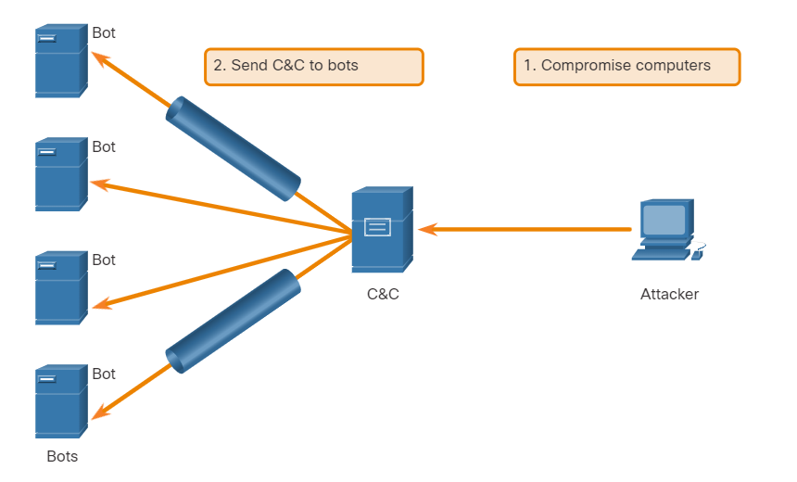
IP Services
DNS Tunneling (Cont.)
A filter that inspects DNS traffic must be used to stop DNS tunneling.
Pay particular attention to DNS queries that are longer than average, or those that have a suspicious domain name.
DNS security solutions, such as Cisco Umbrella, block much of the DNS tunneling traffic by identifying suspicious domains.
Domains associated with Dynamic DNS services should be considered highly suspect.
Notes:
4: Attacking What We Do
4.1: IP Services
4.1.4: DNS Tunneling (Cont.)

Slide 20
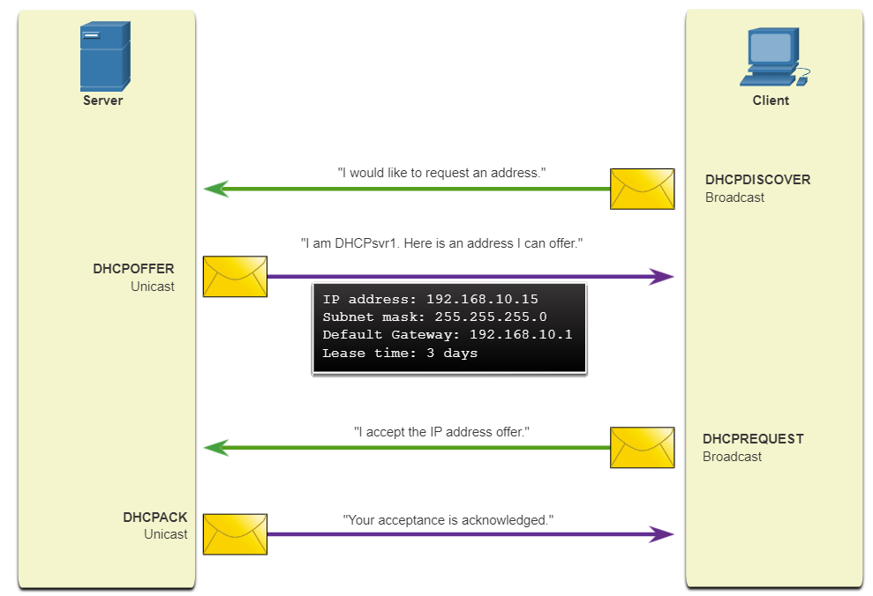
IP Services
DHCP
DHCP servers dynamically provide IP configuration information to clients.
The figure shows the typical sequence of a DHCP message exchange between client and server.
Notes:
4: Attacking What We Do
4.1: IP Services
4.1.5: DHCP

Slide 21
IP Services
DHCP Attacks
Occur when a rogue DHCP server is connected to the network and provides false IP configuration parameters to legitimate clients.
A rogue server can provide a variety of misleading information:
Wrong default gateway - Threat actor provides an invalid gateway, or the IP address of its host to create an MiTM attack. This may go entirely undetected as the intruder intercepts the data flow through the network.
Wrong DNS server - Threat actor provides an incorrect DNS server address pointing the user to a malicious website.
Wrong IP address - Threat actor provides an invalid IP address, invalid default gateway IP address, or both. The threat actor then creates a DoS attack on the DHCP client.
Assume a threat actor has successfully connected a rogue DHCP server to a switch port on the same subnet as the target clients. The goal of the rogue server is to provide clients with false IP configuration information.
Notes:
4: Attacking What We Do
4.1: IP Services
4.1.6: DHCP Attacks

Slide 22
IP Services
DHCP Attacks (Cont.)
The steps in a DHCP spoofing attack are:
Steps | Description
1. Client Broadcasts DHCP Discovery Messages | A legitimate client connects to the network and requires IP configuration parameters. The client broadcasts a DHCP Discover request looking for a response from a DHCP server. A legitimate DHCP Server and a rogue server receive the message.
2. DHCP Servers Respond with Offers | The legitimate and rogue DHCP servers each respond with valid IP configuration parameters. The client replies to the first offer received.
3. Client Accepts Rogue DHCP Request | The client received the rogue offer first. It broadcasts a DHCP request accepting the parameters from the rogue server. The legitimate and rogue server each receive the request.
4. Rogue DHCP Acknowledges the Request | However, only the rogue server unicasts a reply to the client to acknowledge its request. The legitimate server stops communicating with the client because the request has already been acknowledged.
Notes:
4: Attacking What We Do
4.1: IP Services
4.1.6: DHCP Attacks (Cont.)

Slide 23
IP Services
Lab - Exploring DNS Traffic
In this lab, you will complete the following objectives:
Capture DNS Traffic
Explore DNS Query Traffic
Explore DNS Response Traffic
Notes:
4: Attacking What We Do
4.1: IP Services
4.1.7: Lab - Exploring DNS Traffic

Slide 24
4.2 Enterprise Services
Notes:
4: Attacking What We Do
4.2: Enterprise Services

Slide 25
Enterprise Services
HTTP and HTTPS
The common stages of a typical web attack are:
The victim unknowingly visits a web page that has been compromised by malware.
The compromised web page redirects the user, often through many compromised servers, to a site containing malicious code.
When the user visits this site with malicious code an exploit kit scans the software running on the victim’s computer including the OS, Java, or Flash player looking for an exploit in the software.
After identifying a vulnerable software package running on the victim’s computer, the exploit kit contacts the exploit kit server to download code that can use the vulnerability to run malicious code on the victim’s computer.
After the victim’s computer has been compromised, it connects to the malware server and downloads a payload (malware, or a file download service that downloads other malware).
The final malware package is run on the victim’s computer.
Notes:
4: Attacking What We Do
4.2: Enterprise Services
4.2.1: HTTP and HTTPS

Slide 26
Enterprise Services
HTTP and HTTPS (Cont.)
Server connection logs can often reveal information about the type of scan or attack. The different types of connection status codes are listed here:
Informational 1xx - This is a provisional response, consisting only of the Status-Line and optional headers. It is terminated by an empty line. There are no required headers for this class of status code. Servers MUST NOT send a 1xx response to an HTTP/1.0 client except under experimental conditions.
Successful 2xx - The client’s request was successfully received, understood, and accepted.
Redirection 3xx - Further action must be taken by the user agent to fulfill the request. A client SHOULD detect infinite redirection loops, because these loops generate network traffic for each redirection.
Client Error 4xx - This is for cases in which the client seems to have erred. Except when responding to a HEAD request, the server SHOULD include an entity containing an explanation of the situation, and if it is temporary. User agents SHOULD display any included entity to the user.
Server Error 5xx - This is for cases where the server is aware that it has erred or cannot perform the request. Except when responding to a HEAD request, the server SHOULD include an entity containing an explanation of the error situation, and if it is temporary. User agents SHOULD display any included entity to the user.
Notes:
4: Attacking What We Do
4.2: Enterprise Services
4.2.1: HTTP and HTTPS (Cont.)

Slide 27
Enterprise Services
Common HTTP Exploits
Malicious iFrames
Malicious iFrames are often used by threat actors.
It is an HTML element that allows the browser to load another web page from another source.
Threat actors compromise a webserver and modify web pages by adding HTML for the malicious iFrame. It can then be used to deliver a malicious exploit, such as spam advertising, an exploit kit, and other malware.
HTTP 302 Cushioning
Threat actors attack by using the 302 Found HTTP response status code to redirect the user’s web browser to a new location.
The browser believes that the new location is the URL provided in the header and is invited to request this new URL.
This redirect function can be used multiple times until the browser finally lands on the page that contains the exploit.
The redirects may be difficult to detect since legitimate redirects frequently occur on the network.
Notes:
4: Attacking What We Do
4.2: Enterprise Services
4.2.2: Common HTTP Exploits

Slide 28
Enterprise Services
Common HTTP Exploits (Cont.)
Domain Shadowing
To attack, the threat actor must first compromise a domain, then create multiple subdomains of that domain.
Hijacked domain registration logins are then used to create the many subdomains needed for attacks.
Even if the subdomains are found out to be malicious domains, more can be made from the parent domain.
The following sequence is typically used by threat actors:
  A website becomes compromised.
  HTTP 302 cushioning is used to send the browser to malicious websites.
  Domain shadowing is used to direct the browser to a compromised server.
  An exploit kit landing page is accessed.
  Malware downloads from the exploit kit landing page.
Notes:
4: Attacking What We Do
4.2: Enterprise Services
4.2.2: Common HTTP Exploits (Cont.)

Slide 29
Enterprise Services
Email
As the level of email use rises, security becomes a greater priority. Today, HTML messages are accessed from many different devices that are often not protected by the company’s firewall. HTML allows more attacks because of the amount of access that can sometimes bypass different security layers.
The following are examples of email threats:
Attachment-based attacks - Threat actors embed malicious content in business files such as an email from the IT department.
Email spoofing - Threat actors create email messages with a forged sender address that is meant to fool the recipient into providing money or sensitive information.
Spam email - Threat actors send unsolicited email containing advertisements or malicious files.
Open mail relay server - Threat actors take advantage of enterprise servers that are misconfigured as open mail relays to send large volumes of spam or malware to unsuspecting users.
Homoglyphs - Threat actors can use text characters that are very similar or even identical to legitimate text characters.
Notes:
4: Attacking What We Do
4.2: Enterprise Services
4.2.3: Email

Slide 30
Enterprise Services
Email (Cont.)
Just like any other service that is listening to a port for incoming connections, SMTP servers may also have vulnerabilities.
A few actions to help protect against threats include:
Keep SMTP software up to date with security and software patches and updates.
Implement countermeasures to further prevent threat actors from completing their task of fooling the end user.
Use a security appliance specific to email such as the Cisco Email Security Appliance to help detect and block many known types of threats such as phishing, spam, and malware.
Teach the end user how to recognize spam, phishing attempts, suspicious links and URLs, homoglyphs, and to never open suspicious attachments.
Notes:
4: Attacking What We Do
4.2: Enterprise Services
4.2.3: Email (Cont.)

Slide 31
Enterprise Services
Web-Exposed Databases
Web applications commonly connect to a relational database to access sensitive data.
Code Injection
Attackers execute commands on a web server’s OS through a vulnerable web application.
SQL Injection
Threat actors use SQL injections to breach the relational database, create malicious SQL queries, and obtain sensitive data from the relational database.
SQL Injection is one of the most common database attacks.
Security analysts should be able to recognize suspicious SQL queries to detect if the relational database has been subjected to SQL injection attacks.
Security analysts need to be able to determine which user ID was used by the threat actor to log in, then identify any information or further access the threat actor could have leveraged after a successful login.
Notes:
4: Attacking What We Do
4.2: Enterprise Services
4.2.4: Web-Exposed Databases

Slide 32
Enterprise Services
Client-Side Scripting
Cross-Site Scripting (XSS)
XSS occurs when web pages that are executed on the client-side, within their own web browser, are injected with malicious scripts.
Two main types of XSS:
Stored (persistent) - This is permanently stored on the infected server and is received by all visitors to the infected page.
Reflected (non-persistent) - This only requires that the malicious script is in a link and visitors must click the infected link to become infected.
To prevent or reduce XSS attacks:
Be sure that web application developers are aware of XSS vulnerabilities and how to avoid them.
Use an IPS implementation to detect and prevent malicious scripts.
Use a web proxy to block malicious sites.
Use a service such as Cisco Umbrella to prevent users from navigating to websites that are known to be malicious.
Teach end users to identify phishing attacks and notify infosec personnel when they are suspicious of anything security-related.
Notes:
4: Attacking What We Do
4.2: Enterprise Services
4.2.5: Client-side Scripting

Slide 33
Enterprise Services
Lab - Install a Virtual Machine on a Personal Computer
Objectives:
Part 1: Prepare a Computer for Virtualization
Part 2: Import a Virtual Machine into VirtualBox Inventory
Notes:
4: Attacking What We Do
4.2: Enterprise Services
4.2.6: Lab Video - Install a Virtual Machine on a Personal Computer
4.2.7: Lab - Install a Virtual Machine on a Personal Computer

Slide 34
Enterprise Services
Lab - Attacking a MySQL Database
In this lab, you will view a PCAP file from a previous attack against an SQL database.
Part 1: Open Wireshark and load the PCAP file.
Part 2: View the SQL Injection Attack.
Part 3: The SQL Injection Attack continues…
Part 4: The SQL Injection Attack provides system information.
Part 5: The SQL Injection Attack and Table Information.
Part 6: The SQL Injection Attack Concludes.
Notes:
4: Attacking What We Do
4.2: Enterprise Services
4.2.8: Lab - Attacking a MySQL Database

Slide 35
Enterprise Services
Lab - Reading Server Logs
In this lab, you will complete the following objectives:
Reading Log Files with cat, more, and less
Log Files and Syslog
Log Files and journalctl
Notes:
4: Attacking What We Do
4.2: Enterprise Services
4.2.9: Lab - Reading Server Logs
4.2.10: Check Your Understanding - Enterprise Services

Slide 36
4.3 Mitigating Common Network Attacks
Notes:
4: Attacking What We Do
4.3: Mitigating Common Network Attacks

Slide 37
Mitigating Common Network Attacks
Defending the Network
Constant vigilance and ongoing education are required to defend your network against attack.
The best practices for securing a network are:
Develop a written security policy for the company.
Educate employees about the risks of social engineering, and develop strategies to validate identities over the phone, via email, or in person.
Control physical access to systems.
Use strong passwords and change them often.
Encrypt and password-protect sensitive data.
Implement security hardware and software such as firewalls, IPS devices, VPN devices, antivirus software, and content filtering.
Perform backups and test the backed-up files on a regular basis.
Shut down unnecessary services and ports.
Keep patches up-to-date by installing them weekly or daily, if possible, to prevent buffer overflow and privilege escalation attacks.
Perform security audits to test the network.
Notes:
4: Attacking What We Do
4.3: Mitigating Common Network Attacks
4.3.1: Defending the Network

Slide 38
Mitigating Common Network Attacks
Mitigating Malware
Malware, including viruses, worms, and Trojan horses, can cause serious problems on networks and end devices.
Network administrators have several means (or countermeasures) of mitigating these attacks:
Antivirus software
It helps prevent hosts from getting infected and spreading malicious code by detecting and eliminating viruses.
They do not prevent viruses from entering the network, so a network security professional must be aware of the major viruses and keep track of security updates.
Prevent malware files from entering the network
Security devices at the network perimeter can identify and remove known malware files based on their indicators of compromise.
Notes:
4: Attacking What We Do
4.3: Mitigating Common Network Attacks
4.3.2: Mitigating Malware

Slide 39
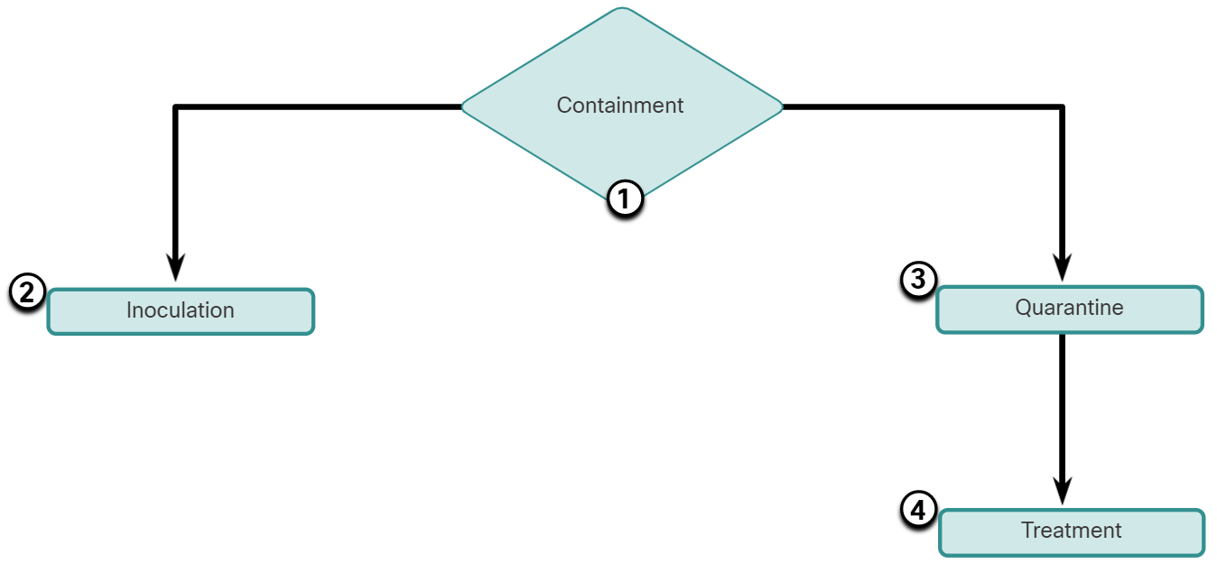
Mitigating Common Network Attacks
Mitigating Worms
Worms are more network-based than viruses.
Worm mitigation requires diligence and coordination on the part of network security professionals.
As shown in the figure, the response to a worm attack can be broken down into four phases: containment, inoculation, quarantine, and treatment.
Notes:
4: Attacking What We Do
4.3: Mitigating Common Network Attacks
4.3.3: Mitigating Worms

Slide 40
Mitigating Common Network Attacks
Mitigating Worms (Cont.)
Phase | Response
1. Containment | The containment phase involves limiting the spread of a worm infection to areas of the network that are already affected. This requires compartmentalization and segmentation of the network to slow down or stop the worm and to prevent currently infected hosts from targeting and infecting other systems. Containment requires using both outgoing and incoming ACLs on routers and firewalls at control points within the network.
2. Inoculation | The inoculation phase runs parallel to, or after, the containment phase. During the inoculation phase, all uninfected systems are patched with the appropriate vendor patch. The inoculation process further deprives the worm of any available targets.
3. Quarantine | The quarantine phase involves tracking down and identifying infected machines within the contained areas and disconnecting, blocking, or removing them. This isolates these systems appropriately for the treatment phase.
4. Treatment | The treatment phase involves actively disinfecting infected systems. This can involve terminating the worm process, removing modified files or system settings that the worm introduced, and patching the vulnerability the worm used to exploit the system. Alternatively, in more severe cases, the system may need to be reinstalled to ensure that the worm and its by-products are removed.
Notes:
4: Attacking What We Do
4.3: Mitigating Common Network Attacks
4.3.3: Mitigating Worms (Cont.)

Slide 41
Mitigating Common Network Attacks
Mitigating Reconnaissance Attacks
Reconnaissance attacks are typically the precursor to other attacks that have the intent of gaining unauthorized access to a network or disrupting network functionality.
A variety of technologies and devices can be used to monitor this type of activity and generate an alarm.
Cisco’s ASA provides intrusion prevention in a standalone device. Additionally, enterprise routers, such as Cisco Integrated Services Routers (ISR), support network-based intrusion prevention with additional software.
Reconnaissance attacks can be mitigated in several ways, including the following:
  Implementing authentication to ensure proper access.
  Using encryption to render packet sniffer attacks useless.
  Using anti-sniffer tools to detect packet sniffer attacks.
  Implementing a switched infrastructure.
  Using a firewall and IPS.
Notes:
4: Attacking What We Do
4.3: Mitigating Common Network Attacks
4.3.4: Mitigating Reconnaissance Attacks

Slide 42
Mitigating Common Network Attacks
Mitigating Reconnaissance Attacks (Cont.)
Anti-sniffer software and hardware tools detect changes in the response time of hosts to determine whether the hosts are processing more traffic than their own traffic loads would indicate.
While this does not eliminate the threat, as part of an overall mitigation system, it can reduce the number of instances of threat.
Encryption is also effective for mitigating packet sniffer attacks. If traffic is encrypted, using a packet sniffer is of little use because captured data is not readable.
It is impossible to mitigate port scanning but using an IPS and firewall can limit the information that can be discovered with a port scanner.
Ping sweeps can be stopped if ICMP echo and echo-reply are turned off on edge routers; however, when these services are turned off, network diagnostic data is lost.
Additionally, port scans can be run without full ping sweeps. The scans simply take longer because inactive IP addresses are also scanned.
Notes:
4: Attacking What We Do
4.3: Mitigating Common Network Attacks
4.3.4: Mitigating Reconnaissance Attacks (Cont.)

Slide 43
Mitigating Common Network Attacks
Mitigating Access Attacks
Techniques for mitigating access attacks: strong password security, principle of minimum trust, cryptography, and applying operating system and application patches.
A surprising number of access attacks are carried out through simple password guessing or brute-force dictionary attacks against passwords. To defend against this, create and enforce a strong authentication policy.
  Use strong passwords - They are at least eight characters and contain uppercase letters, lowercase letters, numbers, and special characters.
  Disable accounts after a specified number of unsuccessful logins has occurred - This helps to prevent continuous password attempts.
The network should also be designed using the principle of minimum trust. This means that systems should not use one another unnecessarily.
Notes:
4: Attacking What We Do
4.3: Mitigating Common Network Attacks
4.3.5: Mitigating Access Attacks

Slide 44
Mitigating Common Network Attacks
Mitigating Access Attacks (Cont.)
Cryptography is a critical component of any modern secure network. The more that traffic is encrypted, the fewer opportunities hackers have for intercepting data with man-in-the-middle attacks.
The use of encrypted or hashed authentication protocols, along with a strong password policy, greatly reduces the probability of successful access attacks.
Educate employees about the risks of social engineering, and develop strategies to validate identities over the phone, via email, or in person.
Multifactor authentication (MFA) has become increasingly common and requires two or more independent means of verification.
Access attacks can be detected by reviewing logs, bandwidth utilization, and process loads.
Notes:
4: Attacking What We Do
4.3: Mitigating Common Network Attacks
4.3.5: Mitigating Access Attacks (Cont.)

Slide 45
Mitigating Common Network Attacks
Mitigating DoS Attacks
To minimize the number of DoS attacks, a network utilization software package should be always running and required by the organization’s network security policy.
DoS attacks can lead to problems in the network segments of the computers being attacked.
Historically, DoS attacks were sourced from spoofed addresses.
Cisco routers and switches support several anti-spoofing technologies, such as port security, DHCP snooping, IP Source Guard, Dynamic Address Resolution Protocol (DAI) Inspection, and access control lists (ACLs).
Notes:
4: Attacking What We Do
4.3: Mitigating Common Network Attacks
4.3.6: Mitigating DoS Attacks

Slide 46
Mitigating Common Network Attacks
Lab - Recommend Threat Mitigation Measures
In this lab, you will complete the following objectives:
Part 1: Review an Incident at a Video Production Company
Part 2: Review an Incident at a Retail Company
Notes:
4: Attacking What We Do
4.3: Mitigating Common Network Attacks
4.3.7: Lab - Recommend Threat Mitigation Measures

Slide 47
4.4 Attacking What We Do Summary
Notes:
4: Attacking What We Do
4.4: Attacking What We Do Summary

Slide 48
Attacking What We Do Summary
What Did I Learn in this Module?
The DNS protocol defines an automated service that matches resource names with the required numeric IP host address A Gratuitous ARP is an unsolicited ARP Reply that can be sent by any client.
A DHCP spoofing attack occurs when a rogue DHCP server is connected to the network and provides false IP configuration parameters to legitimate clients.
Code injection and SQL injection attacks exploit insufficiently validated input fields to send commands to databases or other applications to gain access to private information.
Cross-Site Scripting (XSS) attacks occur when browsers execute malicious scripts on the client and provide threat actors with access to sensitive information on the local host.
Antivirus software is the primary means of mitigating virus and Trojan horse attacks.
Worm attack response can be broken down into four phases: containment, inoculation, quarantine, and treatment.
Reconnaissance attack mitigation can include access authentication, encryption, and the use of anti-sniffer tools, firewalls, and IPS.
Network security best practices can include employee education, the use of strong passwords and encryptions, backup file testing, unnecessary service and port shutdowns, updating patches, and performing security audits.
Notes:
4: Attacking What We Do
4.4: Attacking What We Do Summary
4.4.1: What Did I Learn in this Module?

Slide 49
Module 4
New Terms and Commands
ARP Cache Poisoning DNS open resolver attacks DNS stealth attacks DNS domain shadowing attacks DNS tunneling attacks Fast Flux Double IP Flux Domain Generation Algorithms DHCP Spoofing Attack DHCP Discovery Message DNS Traffic DNS Query Traffic DNS Response Traffic Enterprise Services HTTPS Informational 1xx | Successful Redirection 3xx Client Error 4xx Server Error 5xx Open Web Application Security Project (OWASP) Malicious iFrames HTTP 302 Cushioning Domain Shadowing Attachment-based attacks Open mail relay Homoglyphs Client-side Scripting
Notes:
4.4: Attacking What We Do Summary
4.4.2: Module 4: Attacking What We Do Quiz

